Slide 1
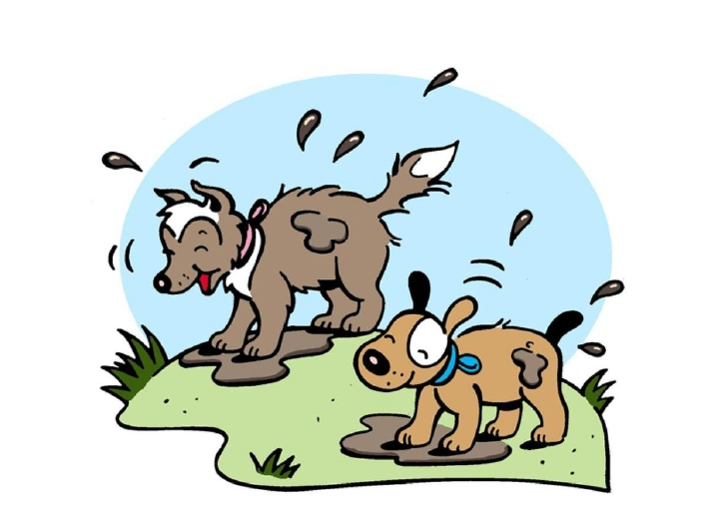
In and Out

Slide 2
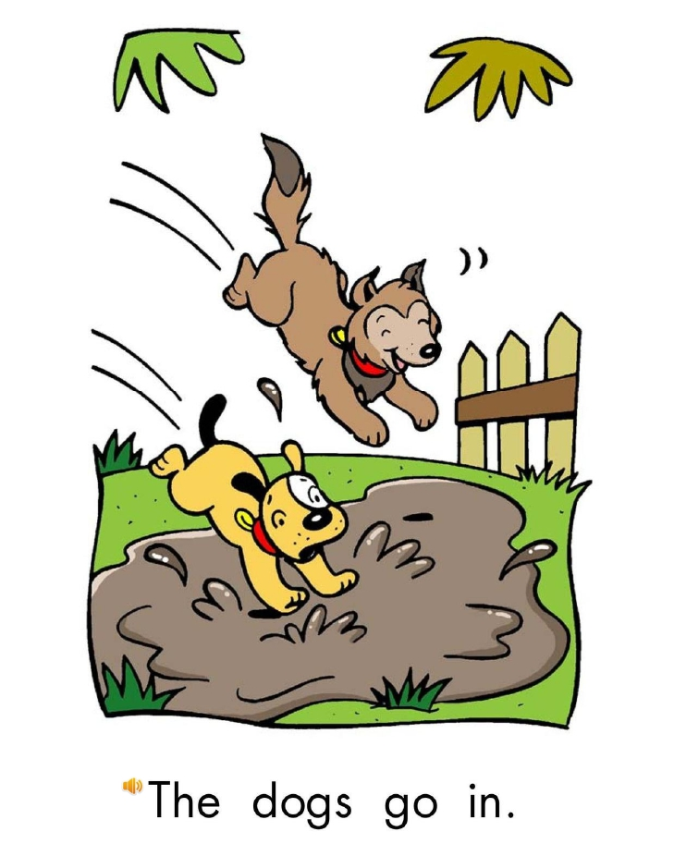
Return

Slide 3
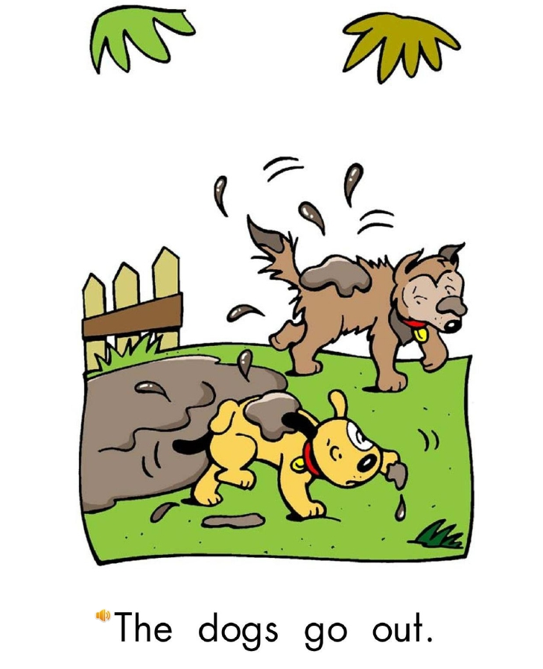
Return

Slide 4
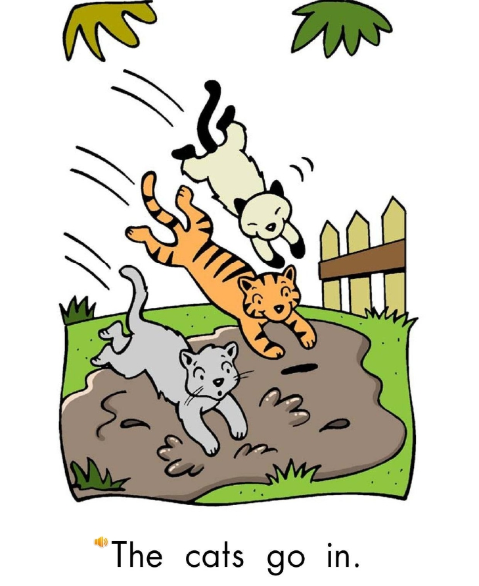
Return

Slide 5
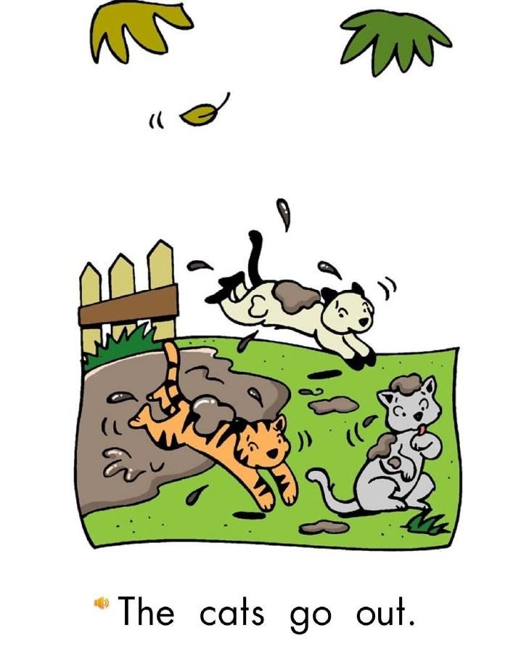
Return

Slide 6
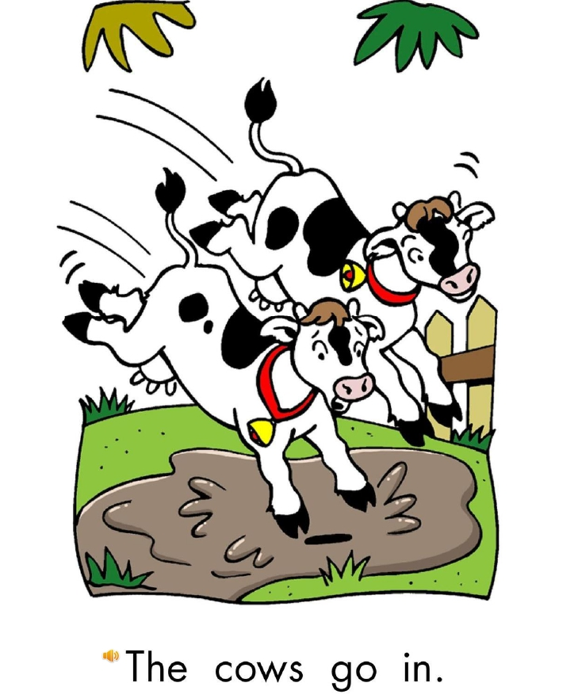
Return

Slide 7
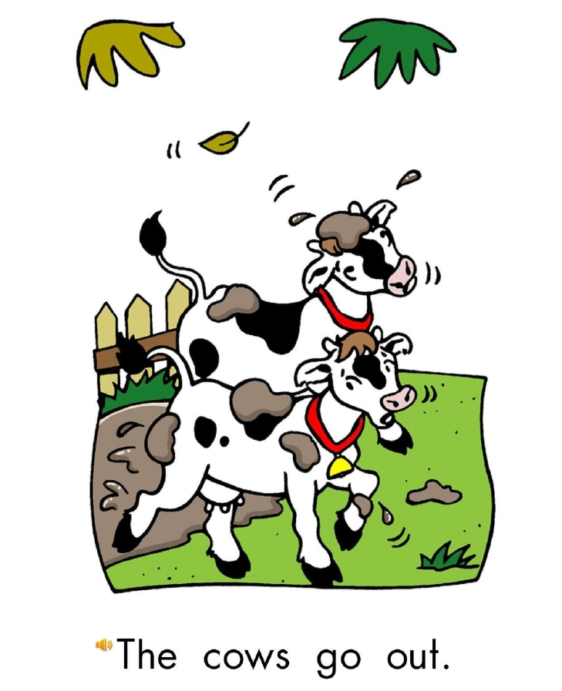
Return

Slide 8
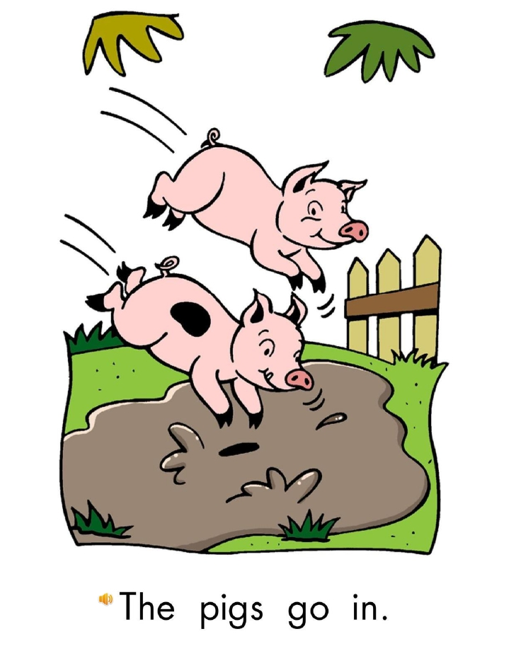
Return

Slide 9
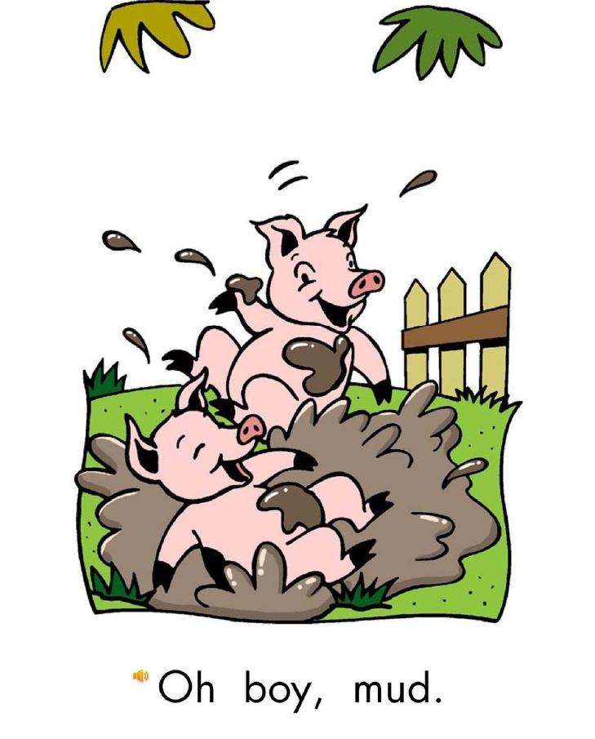
Return

Slide 10
dogs go in
dogs go out
cats go in
cats go out
cows go in
cows go out
mud
Click on the colored buttons to start getting to know the them!

